Slide 1
Software Engineering and the Automotive Industry
Activity #1

Slide 2

Software Engineering
Computers and software were used in WWII to solve general problems
Now, software is all around us with personal computers, phones, sensors, etc.
Software makes life convenient (electronics, appliances, GPS, lights)
As computer software becomes more sophisticated, it will help people with more complex challenges.
Notes:
The World Has Been Changed by Software (mapcon.com)

Slide 3
The Automotive Industry’s Evolution
Innovations
AI and Smart Technology
Hardware
Technological innovations have stirred competition and growth in nearly every industry, from healthcare, to education to automotive.
The motor industry has seen advancements in AI and smart technology that have changed the face of motorized vehicles.
With hardware production and tech features being created every day, automobile software continues to advance with no sign of slowing down.
Notes:
How Technology Has Changed the Car Industry (totalcardiagnostics.com)

Slide 4
Improvements
Some improvements that software brought to the car industry are:
Car Safety Software
Navigation Software
Communication Software
Entertainment Software
Supported by Supervisory Control and Data Acquisition (SCADA) Capabilities
Notes:
The Evolution of Software in the Automotive Industry: The Complete Overview - TechBullion

Slide 5
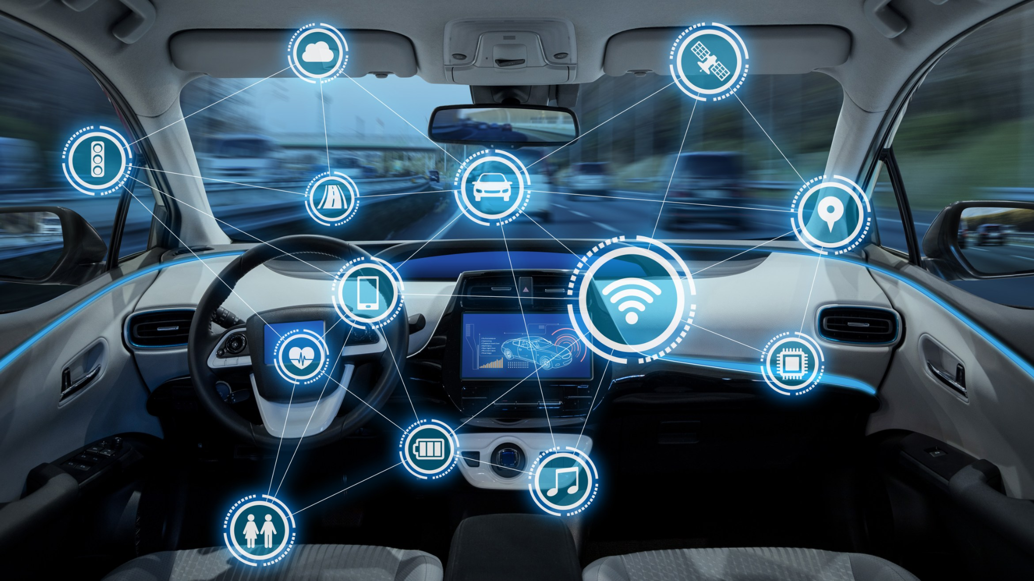
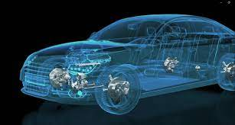

Technology in Cars
Pros
Technologies help drivers to stay concentrated on the road
Anticipation and prevention of possible accidents
Prevention of dangerous driving habits that might cause a crash
Cons
Computers tend to malfunction
Software programs might have bugs
Technology malfunctions while the car is on the road can be extremely dangerous
Notes:
The Pros and Cons of New Auto-Digital Technologies - Chalik & Chalik (chaliklaw.com)

Slide 6

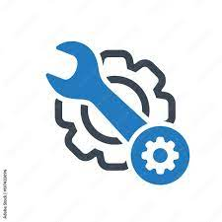


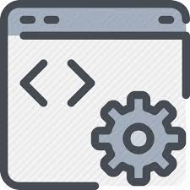

Hardware and Software Development Lifecycle
Software development projects, and specially the ones including hardware, require following a series of stages:
Analysis
Design
Development
Testing
Implementation
Maintenance
Analysis
Maintenance
Design
Implementation
Development
Testing
Notes:
Software Development Process - 6 Stages Of SDLC | SynapseIndia

Slide 7
Analysis
Detailed analysis of the software is performed
Identification of overall requirements of end goal
Necessary to make adjustments
Ensure that software functions properly at the end
Questions that you might ask:
Who are your stakeholders?
What are the end goals of the project?
What functions does your project need to perform?
Notes:
Software Development Process - 6 Stages Of SDLC | SynapseIndia

Slide 8
Design
Building the architecture of the project (software and hardware)
Remove possible flaws by setting a standard and attempting to stick to it
Hypothesize on what needs to be done to make the project work
Questions that you might ask:
How are you going to build the project?
What are your requirements?
What are your assumptions?
Notes:
Software Development Process - 6 Stages Of SDLC | SynapseIndia

Slide 9
Development
Start the actual software development process (machine learning models)
Create the components and functionalities of software and hardware
Make sure that hardware and software components work together
Questions that you might ask:
What tools are you going to use to develop the project?
How are you going to use those tools?
How are you going to make sure that the software and hardware work together?
Notes:
Software Development Process - 6 Stages Of SDLC | SynapseIndia

Slide 10
Testing
Assess the software for errors
Document bugs if any
Identify potential flaws of project
See what can be improved
Does it work the way you want it to?
Questions that you might ask:
How are you going to test the project?
What went right?
What went wrong and why?
How can you fix what went wrong?
Notes:
Software Development Process - 6 Stages Of SDLC | SynapseIndia

Slide 11
Implementation
Crucial step for any project
Running software and hardware and assess it with stakeholders
Ensure the completeness of goals
Did it work out as you expected it to?
Questions that you might ask:
How are you going to implement the project?
How are you going to make sure that the objectives are met?
What are your validation metrics?
Notes:
Software Development Process - 6 Stages Of SDLC | SynapseIndia

Slide 12
Maintenance
Software and hardware is maintained and updated from time to time
Adapt the project for changes in environment
Make sure that the objectives are still being met, despite changes
Questions that you might ask:
Thinking into the future, what are some potential changes for the software?
How could the project change if there is an update in any type of software?
How are you going to check if there are changes in the environment?
Notes:
Software Development Process - 6 Stages Of SDLC | SynapseIndia

Slide 13
Activity
As an engineer, planning ahead is one of the most important things to do before a project. Think about the 6 different steps for making a software and hardware project and write 3-4 sentences about what is your plan for each step while doing the Donkey-Car kit project. You can be as creative as you’d like.

Slide 14
References
Software Development Process - 6 Stages Of SDLC | SynapseIndia
The Pros and Cons of New Auto-Digital Technologies - Chalik & Chalik (chaliklaw.com)
How Technology Has Changed the Car Industry (totalcardiagnostics.com)
The World Has Been Changed by Software (mapcon.com)

